Slide 1
PROJECT TITLE:
KIDNEY DISEASE ANALYSIS
Submitted By:
A. Keerthi Reddy
Ch. Lakshmipriyanka
A. L. S. D.Ruchitha
M. Rohitha Reddy
D. Sarath.

Slide 2
WHAT IS MACHINE LEARNING?
Machine learning is an application of artificial intelligence(AI) that provide system the ability to automatically learn and improve from past experience on its own.
Machine learning focuses on the development of computer programs that can access data .

Slide 3
TYPES OF MACHINE LEARNING??
Supervised learning
Unsupervised learning
Reinforcement
Supervised learning:- that means having a full set of labeled data while training
Unsupervised:- is that of trying to find hidden structure in unlabeled data.
Reinforcement:- it depends on previous data

Slide 4
Classification:-
Classification is nothing but breaking the outcome into some of groups. If it is broken into one or two groups then it is binary classification otherwise, it is multi-class classification it is discrete data. Regression :-
It is relationship between dependent variable with a given set of independent variable it is a linear regression it is continuous of quantity in data. Clustering:-
Is a task of grouping together a set of objects.

Slide 5


Slide 6
APPLICATIONS IN DAY–TO-DAY LIFE
Social media services
E-mail spam
Online customer support
Product recommendation
Online fraud detection
Weather reporting
Medical dialysis

Slide 7
KIDNEY DISEASE ANALYSIS INTRODUCTION BY COLLECTION OF DATA SET
Kidney data set:-
The data set is based on implementation of any kidney disease analysis project that builts the measuring accuracy by the help of Machine learning.
Fields:-
Id-id
Age-age
Bp-Blood pressure
Sg -Sugar
Al-Albuim
Su-Sucrose
Pc- Polycystic
Pcc- Pheochromocytoma

Slide 8
Bgr- Blood glucose random
Bu- Blood urea
Sc- Serum creatinine concentration
Sod- Superoxide dismutase
Pot- Postural orthostatic tachycardia
Hemo- Hemoglobin
Pcv- Packed cell volume
Wc- Waist circumference
Rc- Renal corticomedullary
Htn- Hypertension
Dm- Damage blood vessels
Cad- Coronary artery disease
Appet-Appetite
Pe- Pulmonary embolism
Ckd-Chronic kidney disease

Slide 9
ImportED packages
Numpy
Pandas
Seaborn
Matplotlib
Sklearn(Logistic Regression, SVC, Decision Tree Classifier,
Random Forest Classifier)

Slide 10
NUMPY
Numpy is a python package which stands for ‘numerical python’.
It is done multi-dimensional
It is the core library for scientific computing, which contains a powerful n-dimensional array object, provide tools for integrating c, c++ etc.
Numpy array can also be used as an efficient multi-dimensional container for generic data.
How to import numpy?
import numpy as np

Slide 11
pandas: We creating rows and as well as columns Key features of pandas:
fast and efficient dataframe object with default and customized indexing.
Tools for loading data into in-memory data objects from different file formats.
Data alignment and integrated handling of missing data.
Reshaping and pivoting of date sets.
Label-based slicing, indexing and subsetting of large data sets.
Columns from a data structure can be deleted or inserted.
Group by data for aggregation and transformations.
High performance merging and joining of data.
Time series functionality.

Slide 12
Data Structure | Dimensions | Description
Series | 1 | 1D labeled homogeneous array, sizeimmutable.
Data Frames | 2 | General 2D labeled, size-mutable tabular structure with potentially heterogeneously typed columns.
Panel | 3 | General 3D labeled, size-mutable array.

Slide 13
Sklearn
To run cross validation on multiple matrix and it returns the train test value.
sklearn.preprocessing.imputer(missing_values='nan', strategy='mean', axis=0, verbose=0, copy=true)
missing_values : integer or “nan”, optional (default=”nan”)
the placeholder for the missing values. all occurrences of missing_values will be imputed. for missing values encoded as np.nan, use the string value “nan”.
axis : integer, optional (default=0)
The axis along which to impute.
if axis=0, then impute along columns.
if axis=1, then impute along rows.

Slide 14

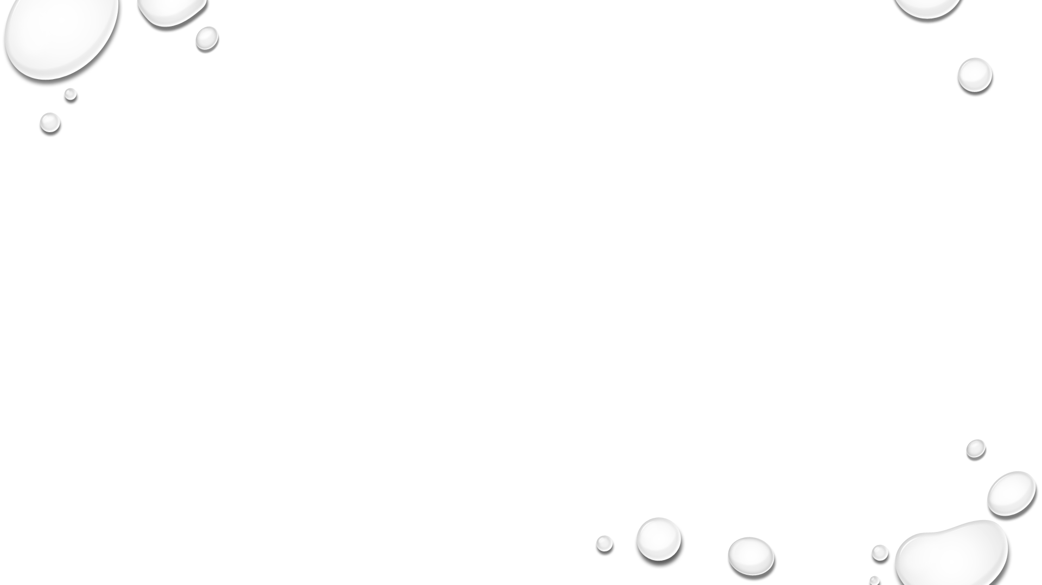
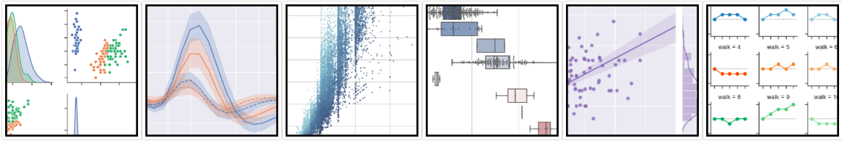
Seaborn
Seaborn is a python data visualization library based on matplotlib.
It provides a high-level interface for drawing attractive and informative statistical graphics.
Seaborn : statistical data visualization

Slide 15
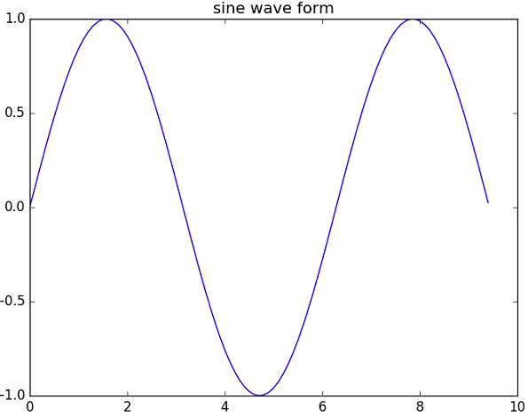
Matplotlib
Matplotlib is a python library used to create 2D graphs and plots by using python scripts.
It has a module named pyplot which makes things easy for plotting by providing feature to control line styles, font properties, formatting axes etc. It supports a very wide variety of graphs and plots namely - histogram, bar charts, power spectra, error charts etc.

Slide 16

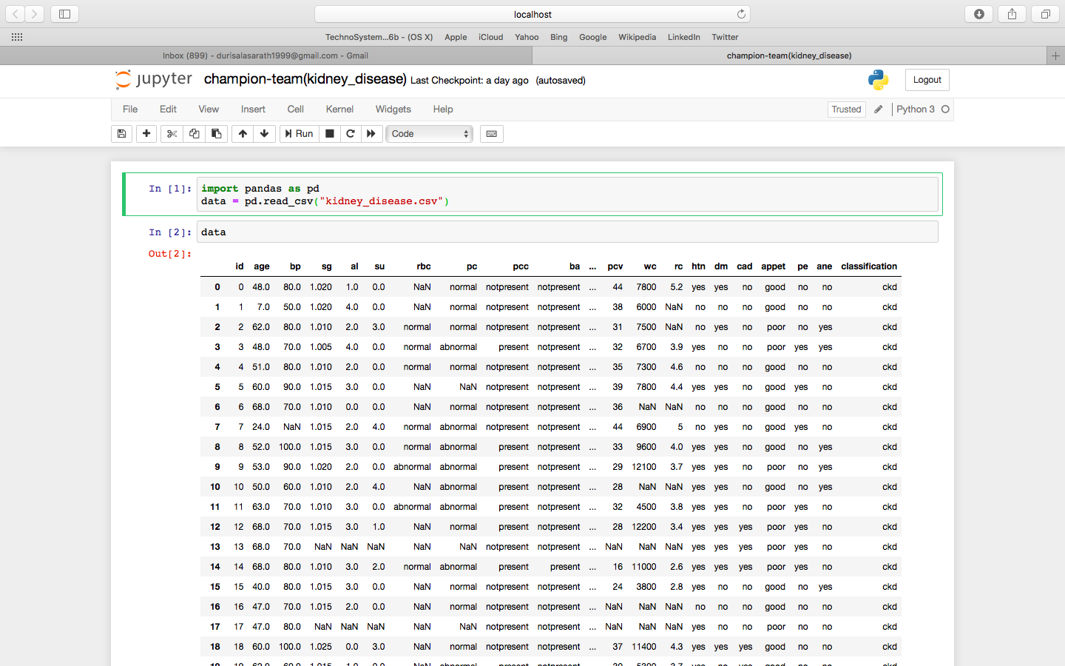
Reading the data from the given dataset(“kidney disease.csv”) and loading the dataset into an variable “data “

Slide 17
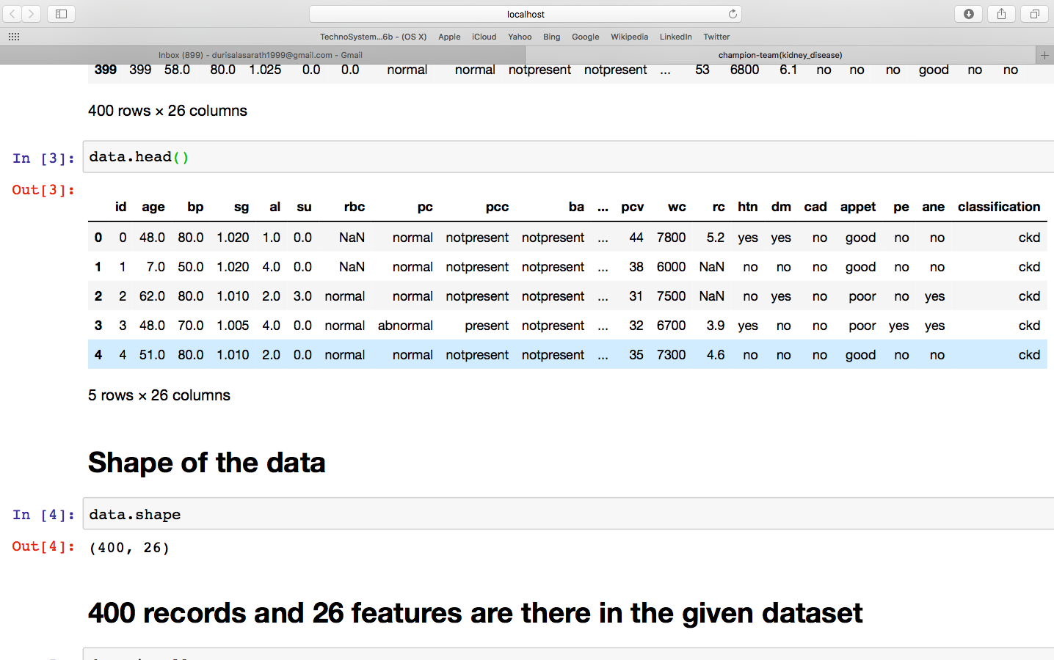
Head is function to display the data from dataset (defautly it will display first five of dataset) and shape is used to print number of rows and number of columns

Slide 18
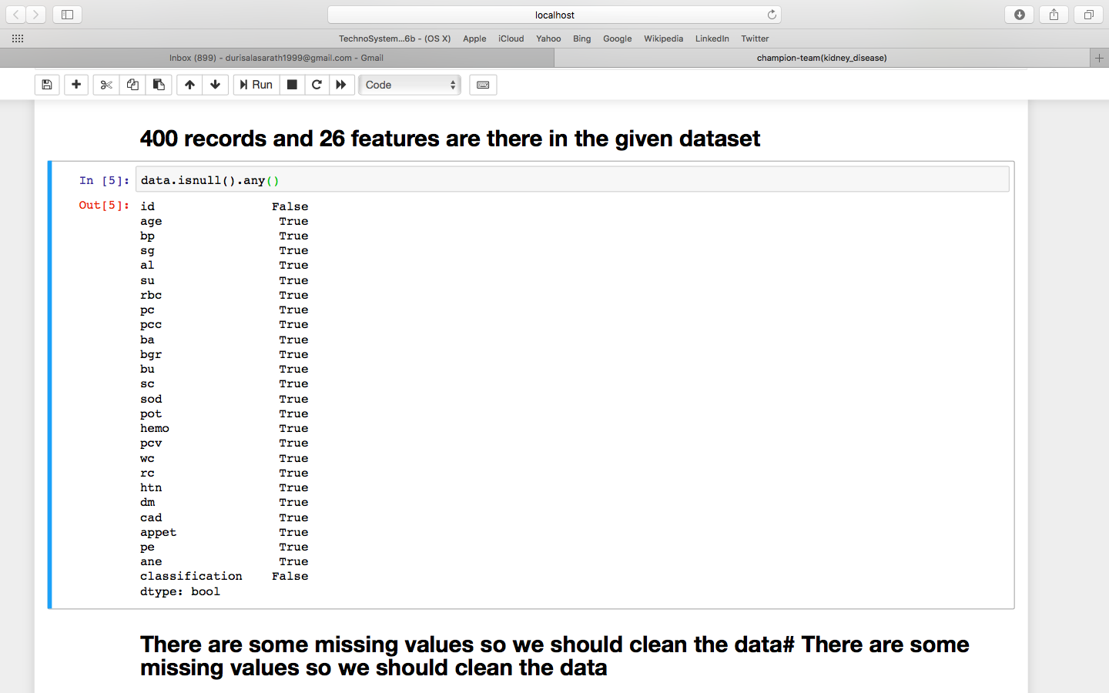
Checking the NULL values in a dataset

Slide 19
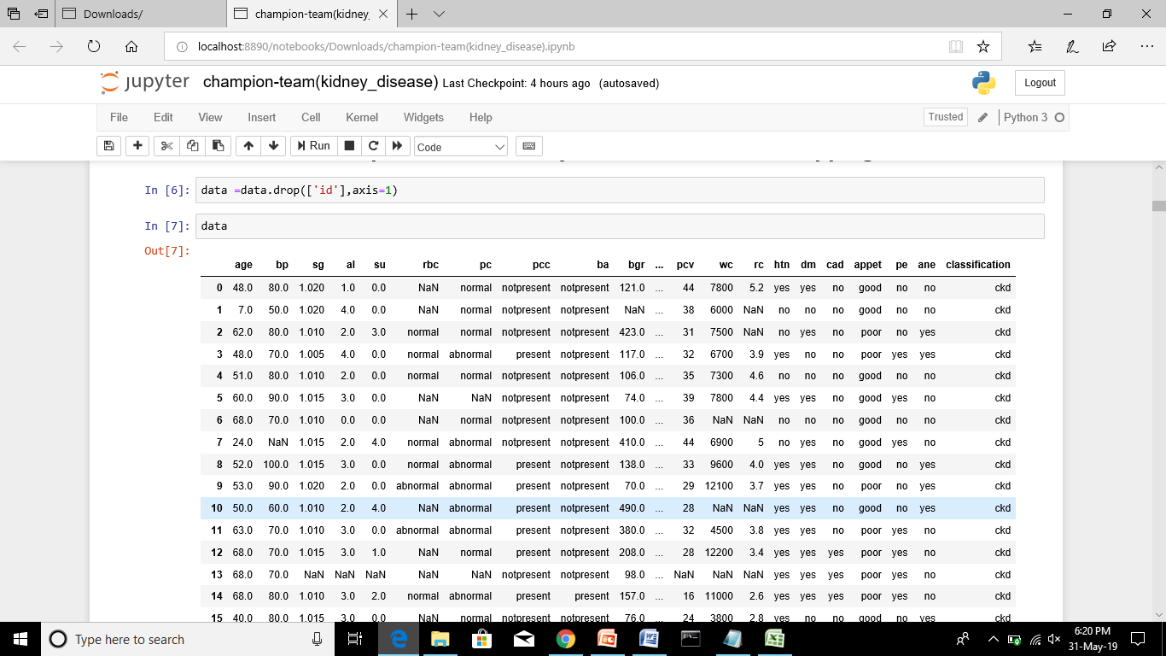
There are some missing values so we should clean the data “id” doesn’t effect presence of kidney disease, so we are dropping it.

Slide 20
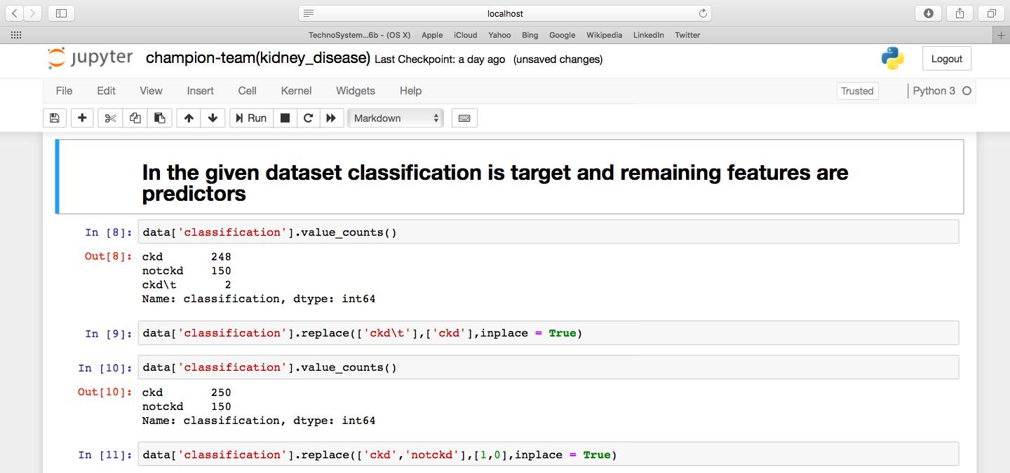
Converting string into integers
The given dataset contain strings we are changing into integers
Classification is target and remaining features are predictors
Doing for the remaining features in a dataset

Slide 21
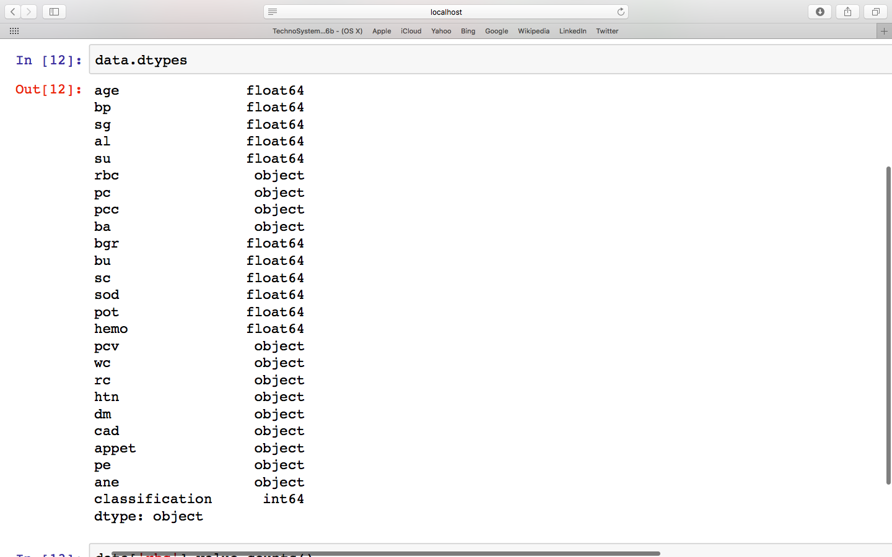
DATATYPES

Slide 22
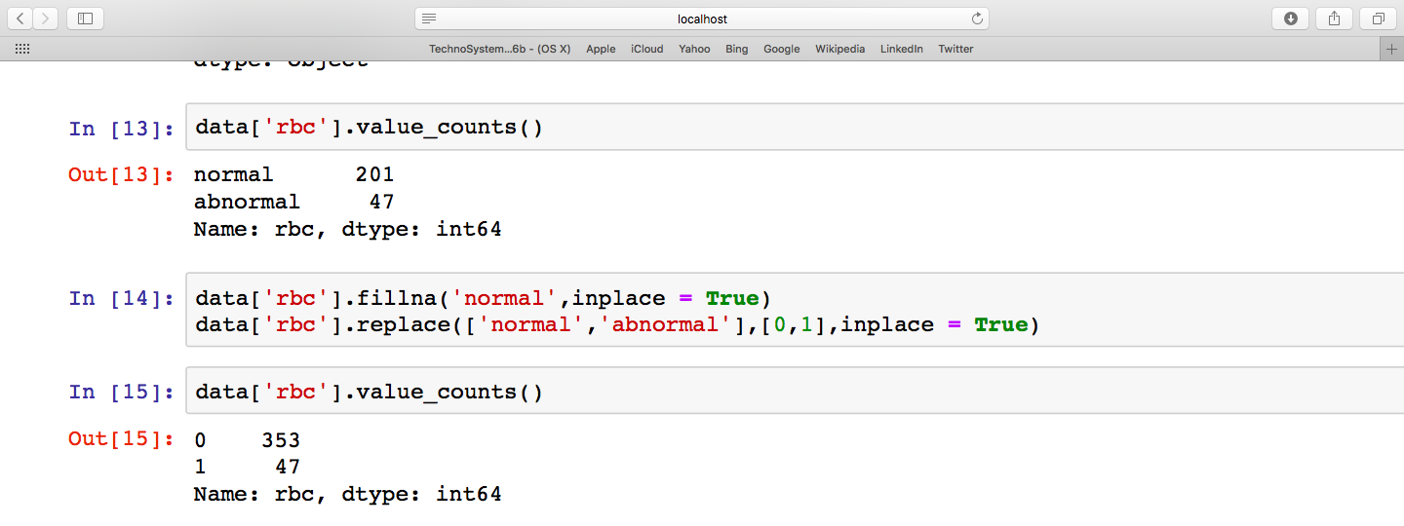
The dataset containing string values we are changing into the integers by giving the
Normal=0(True), abnormal=1(False) And counting values in a dataset and we are doing for
remaining features also as the same done for the rbc.

Slide 23
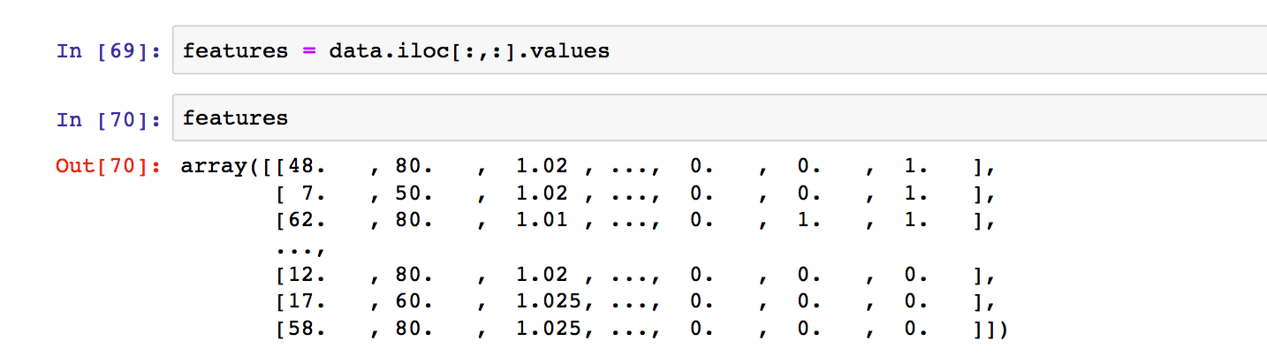
Features values in dataset
In this we printing features values in the dataset “iloc” is the moving for the I locations and printing values of the all features in dataset of kidney_disease.csv

Slide 24
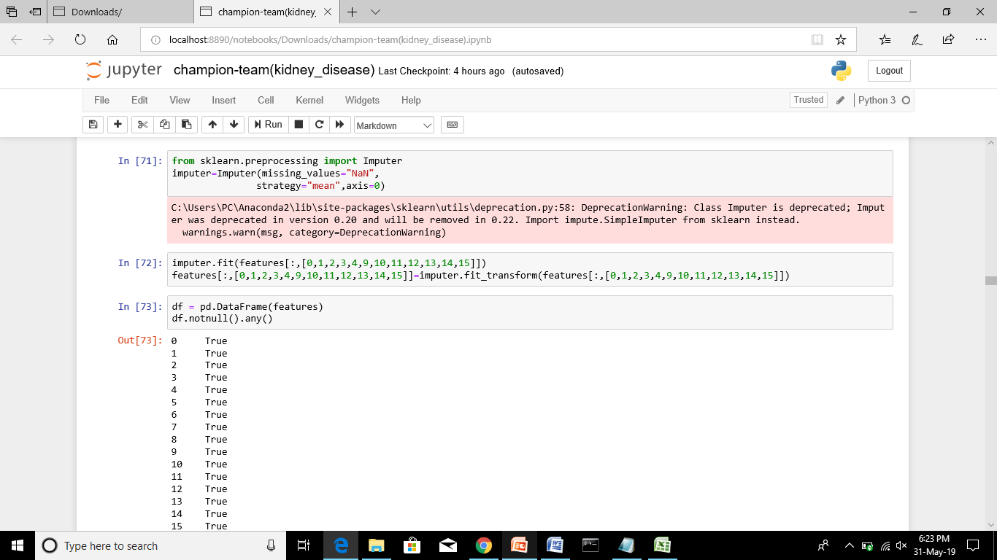
Cleaning the features values containing “nan“ values on the given dataset and checking the null values whether data contain null values

Slide 25
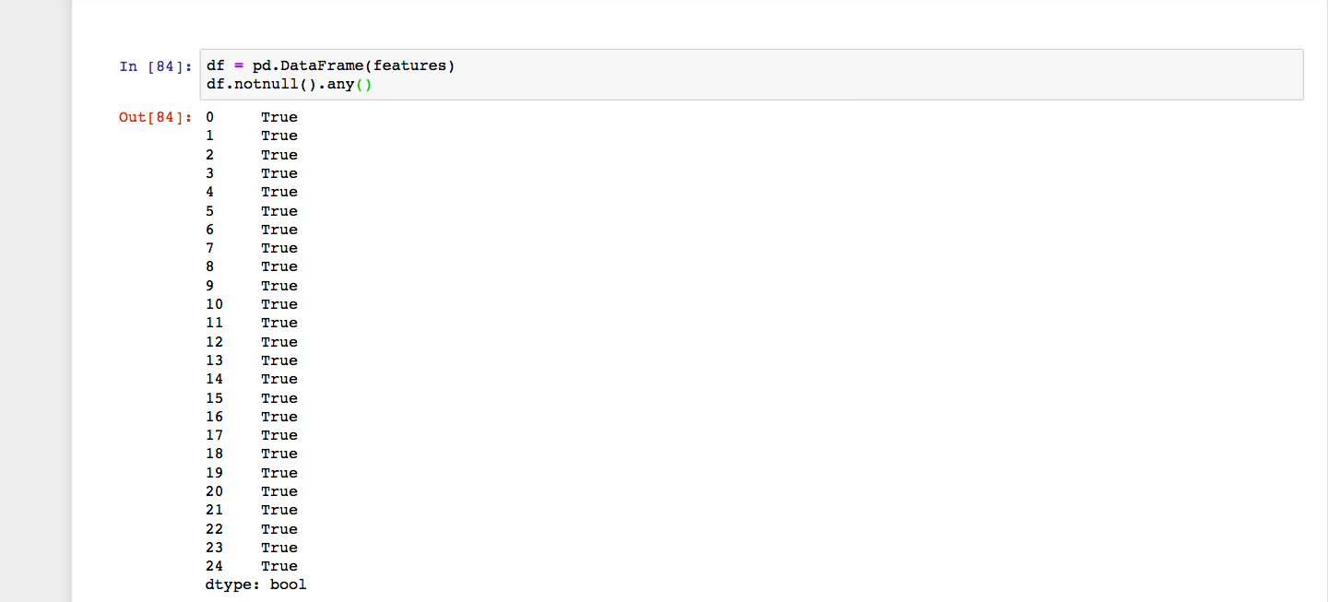
In this checking the null values in the of features and cleaning the null values in dataset of kindey_disease

Slide 26
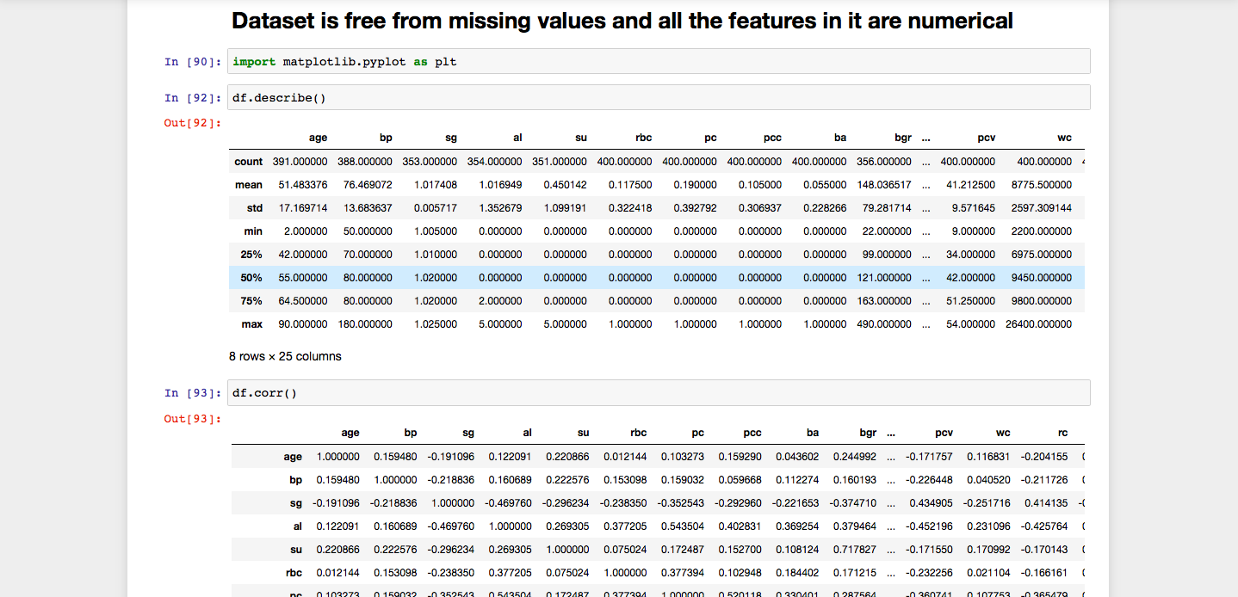
And the dataset is free from missing values of all the features in it are numerical description of dataset features

Slide 27
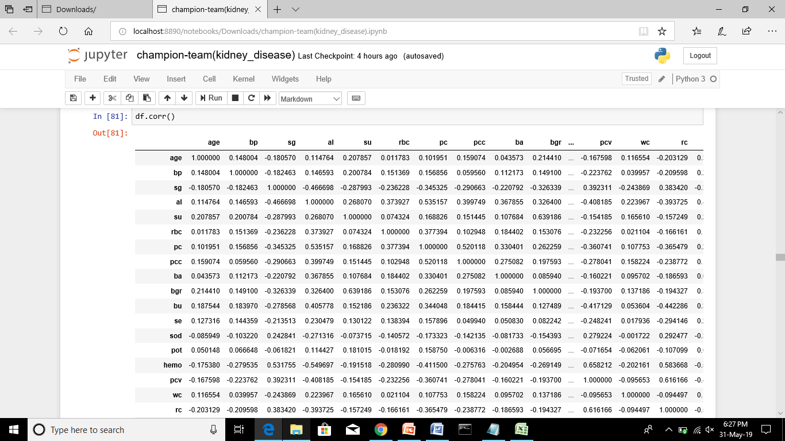
Correlation:

Slide 28
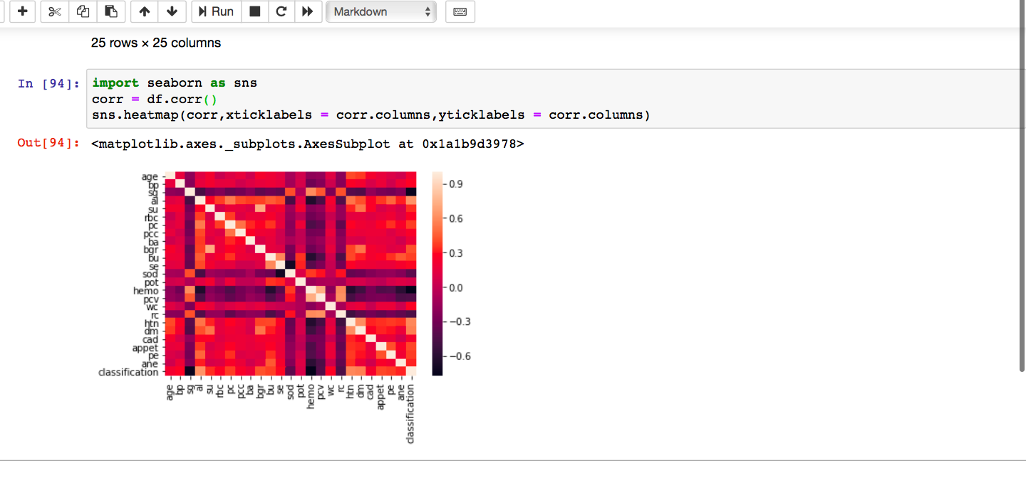
Correlation heatmap of the all features

Slide 29
From heatmap we can say that sg, hemo, sod, pcv, rc are negatively correlated with classification with their decreas, disease is increasing.

Slide 30
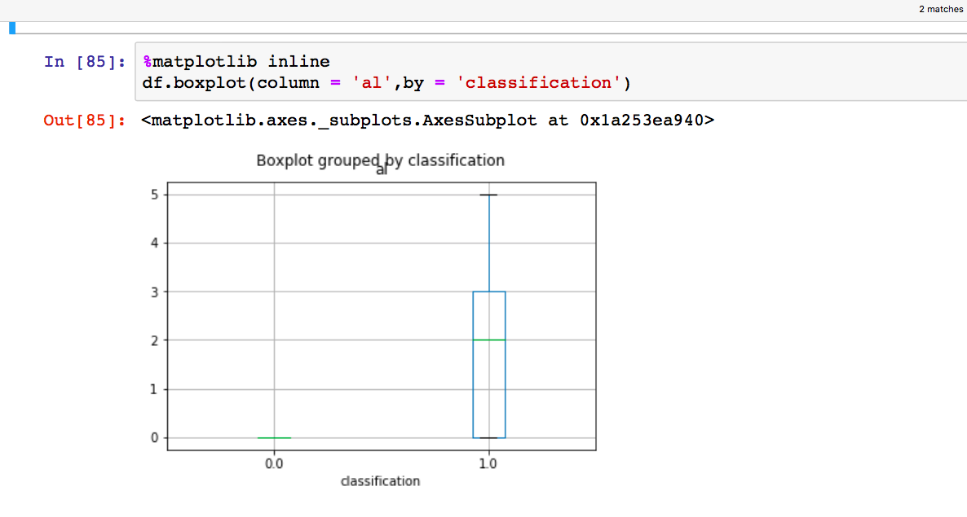
It is boxplot on the albium and classification.

Slide 31
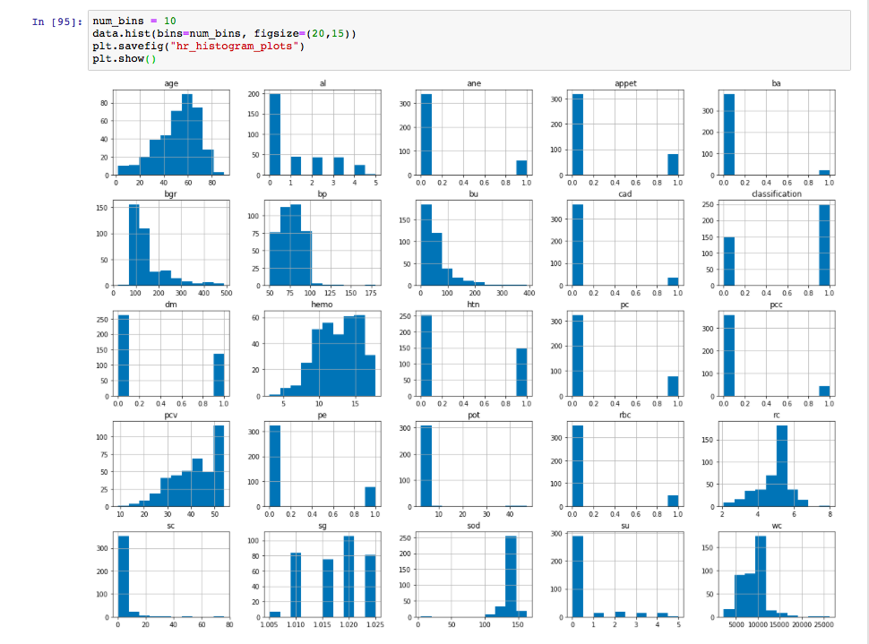
Histogram graph on the all features in dataset.

Slide 32
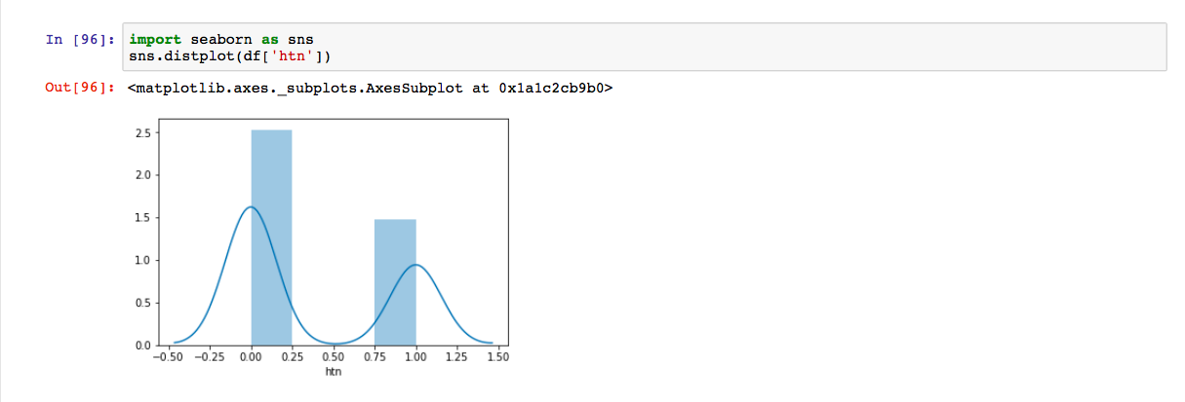
Displot graph on hypertension

Slide 33
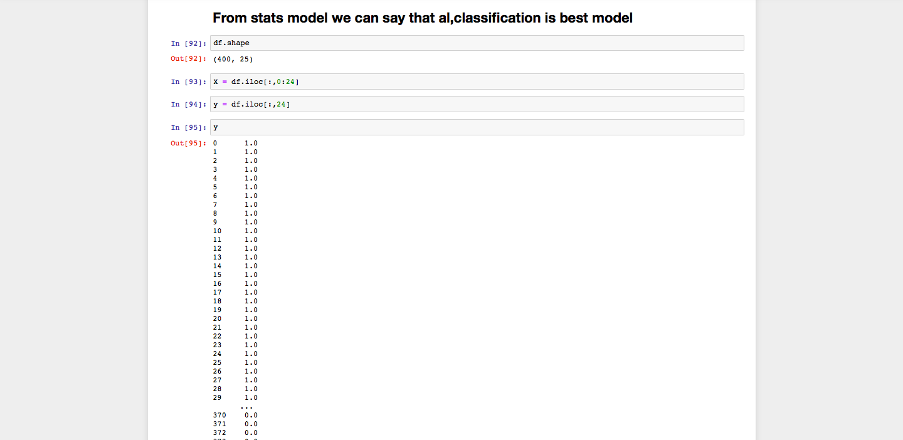
In this we assigning the values to x and y

Slide 34
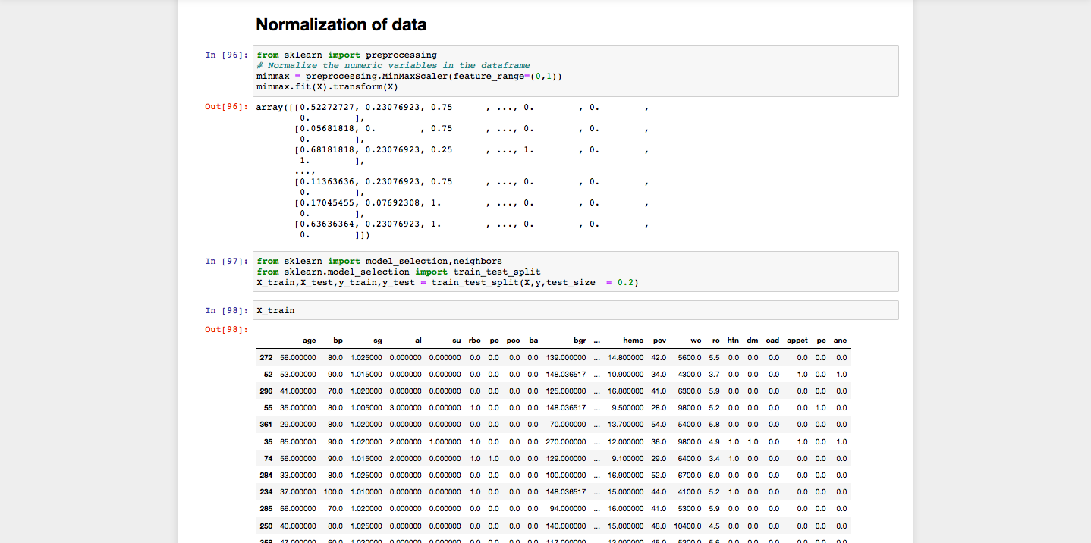
Normalization of data normalization refers to rescaling real valued numeric attributes into the range 0 and 1

Slide 35
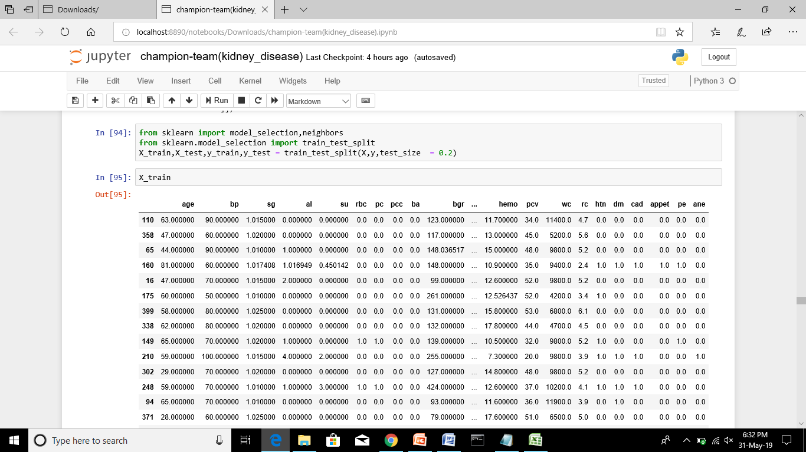
Train it is used for splitting and also test the train values.

Slide 36
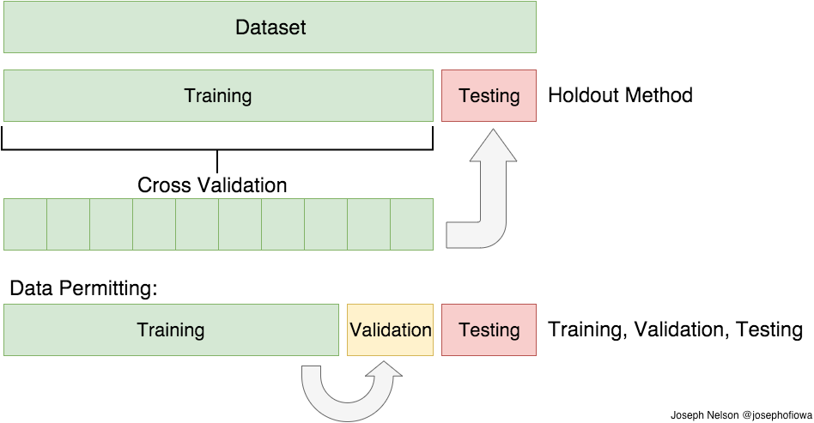

Slide 37
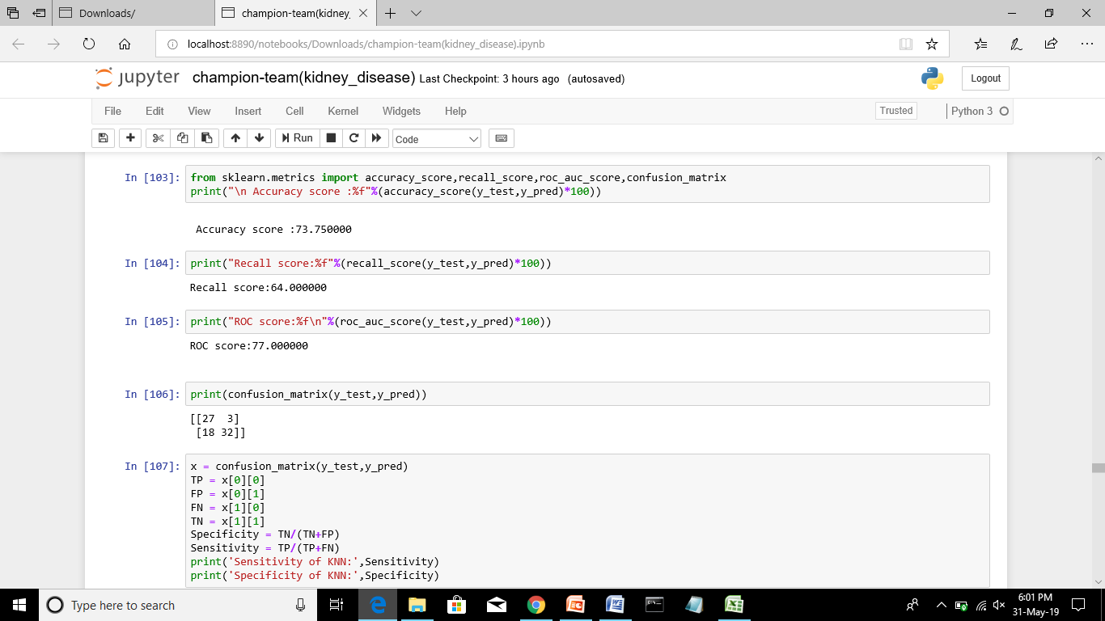
K nearest Neighbour: The model for knn is the entire training dataset. When a prediction is required for a unseen data instance, the knn algorithm will search through the training dataset for the k-most similar instances.

Slide 38
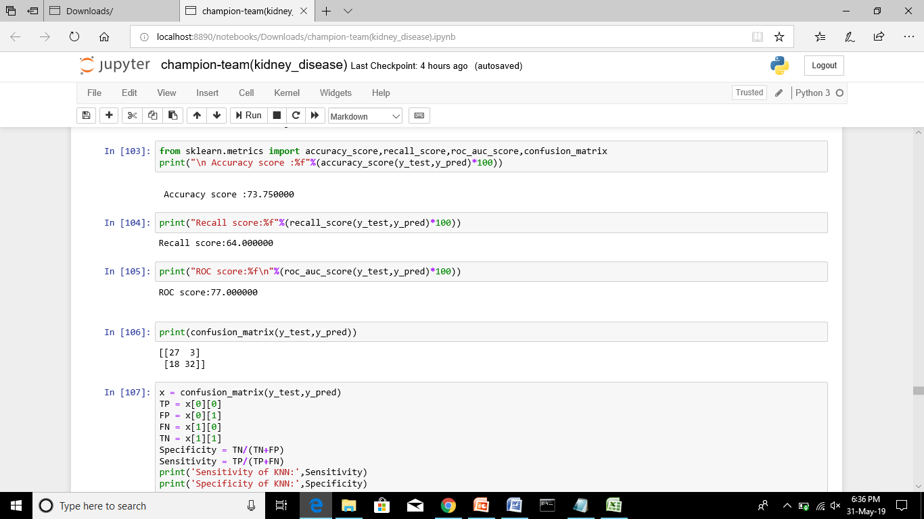

Slide 39
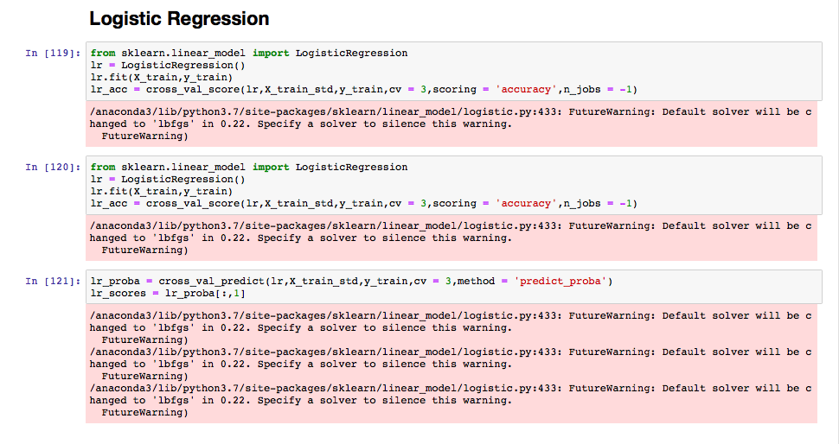
Logistic regression is a machine learning classification algorithm that is used to predict the probability of a categorical dependent variable

Slide 40
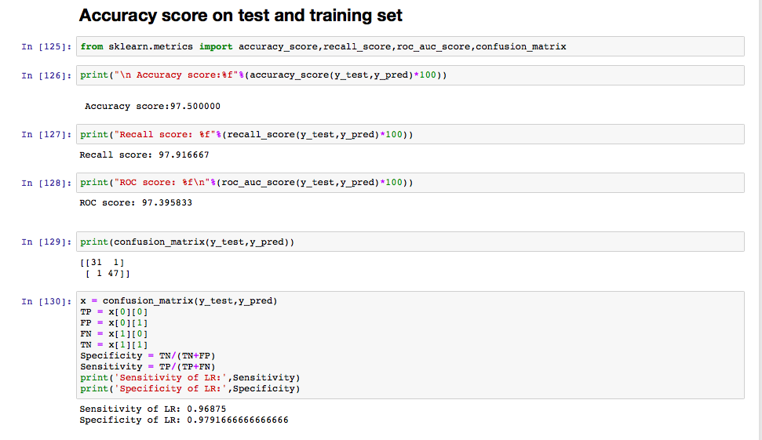
Accuracy score on test and training set

Slide 41
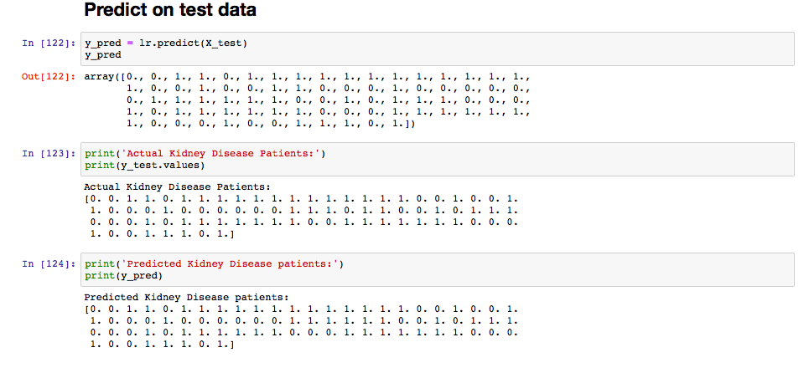
Predict on test data in this dataset we predict the classification whether CKD or NON-CKD

Slide 42
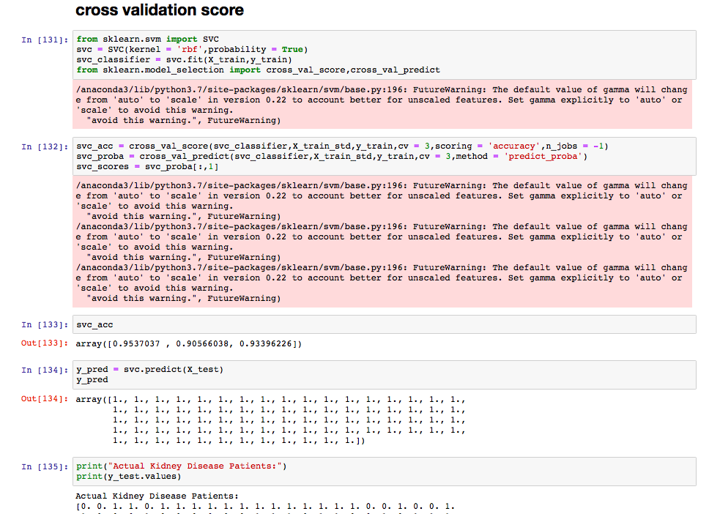
Cross validation: Extension of data split. It will done simple dataset .

Slide 43
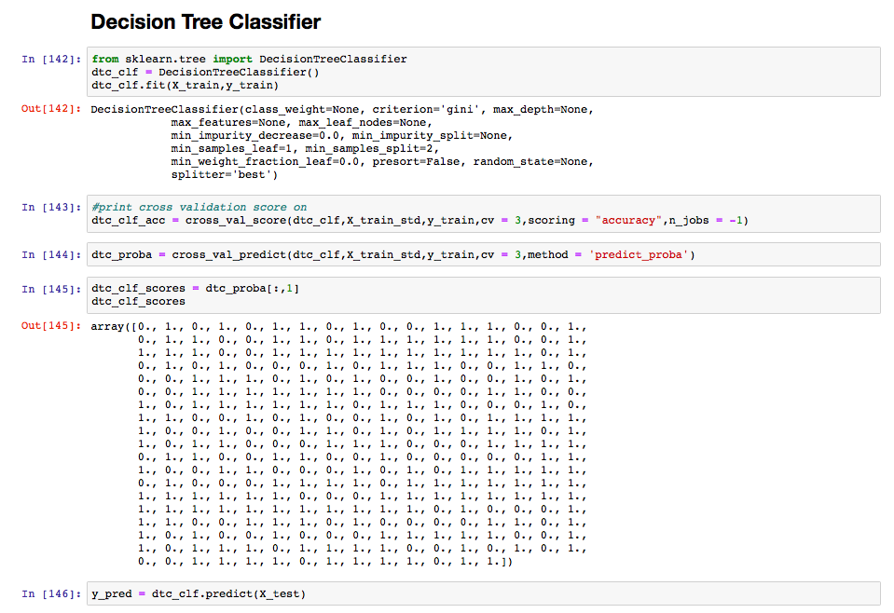
Decision tree classifier: Decision trees are a non-parametric supervised learning method used for both classification and regression tasks. The goal is to create a model that predicts the value of a target variable by learning simple decision rules inferred from the data features

Slide 44
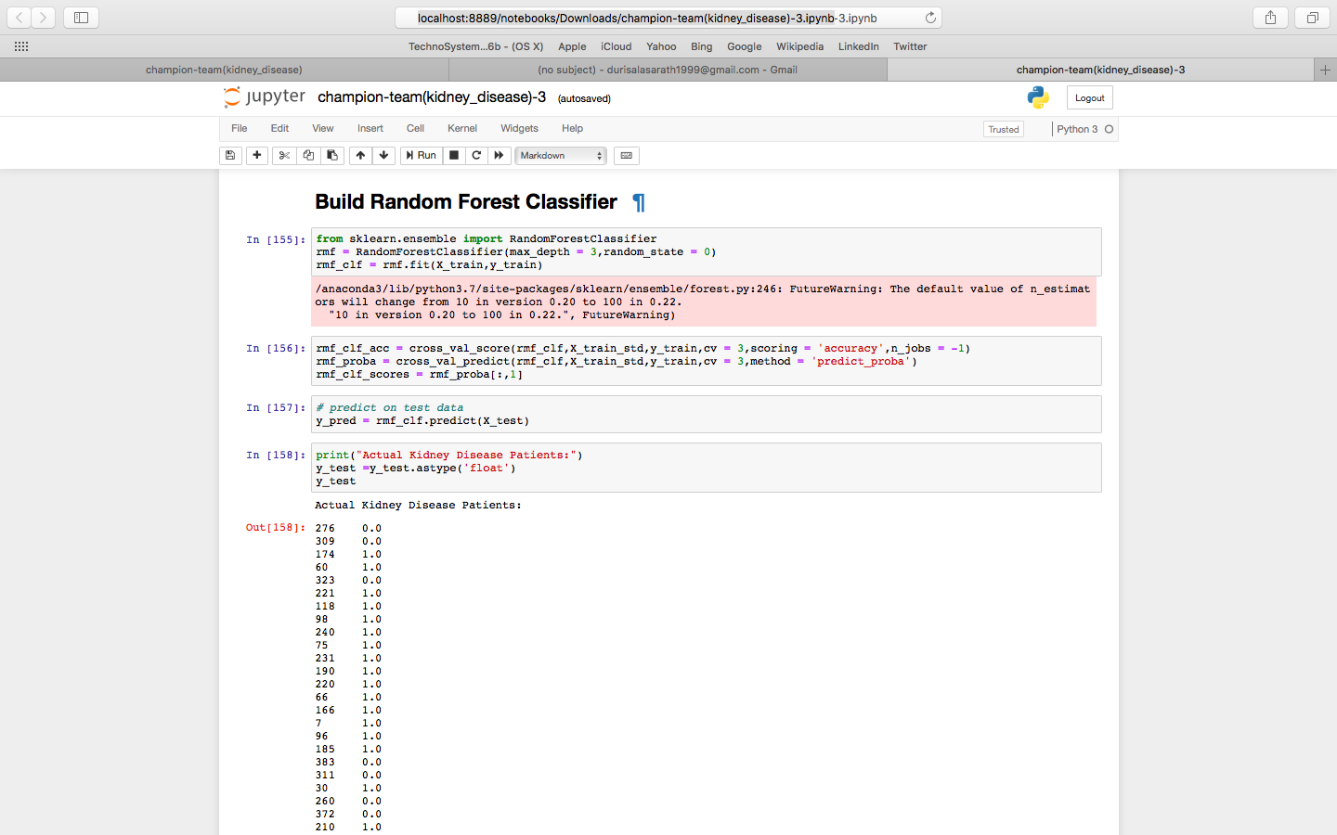
Build random forest classifier: Random forest classifier creates a set of decision trees from randomly selected subset of training set. It then aggregates the votes from different decision trees to decide the final class of the test object

Slide 45
KNN
Accuracy of the model = 71.25%
Recall score = 62.74%
ROC score = 74.47%
Confusion matrix(TP = 25,FP = 4,FN = 19,TN = 32)
Sensitivity of KNN : 0.5681818181818182
Specificity of KNN: 0.8888888888888888
Logistic Regression
Accuracy of the model = 98.75%
Recall score = 100%
ROC score = 98.27%
Confusion matrix(TP = 28,FP = 1,FN = 0,TN = 51)
Sensitivity of LR: 1.0
Specificity of LR: 0.98

Slide 46
SVC
Accuracy of the model = 63.75%
Recall score = 100%
ROC score = 50%
Confusion matrix(TP = 0,FP = 29,FN = 0,TN = 51)
Sensitivity: nan
Specificity of SVM: 0.6375
DTC
Accuracy of the model = 98.75%
Recall score = 98.03%
ROC score = 99.01%
Confusion matrix(TP = 29,FP = 0,FN = 1,TN = 50)
Sensitivity of DTC: 0.97
Specificity of DTC: 1.0

Slide 47
BCRF
Accuracy of the model = 97.50
Recall score = 98.03
ROC score = 97.29
Confusion matrix(TP = 28,FP = 1,FN = 1,TN =50)
Sensitivity of BRFC:0.96
Specificity of BRFC: 0.98
By performing all the models ,I observed that DTC,LR,BRFC are better than other models.
So I conclude that LR and DTC is best model

Slide 48
THANK YOU

